Slide 1
Introduction to Computing
Computer Networks
Advanced Topics

Slide 2
Computer Networks – Advanced Topics
ISO’s OSI Reference Model
TCP/IP Protocol Suit
Types of Addresses
Address Translation
IP Addressing
Interconnection Devices
WAN Interconnection
Network Services & Protocols

Slide 3
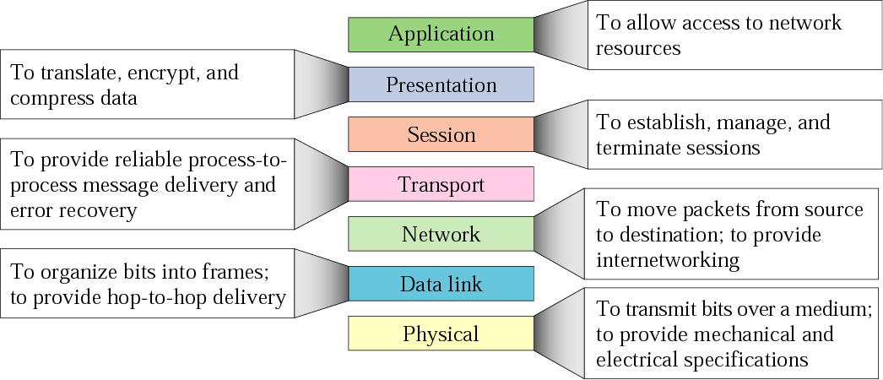
ISO’s OSI Reference Model

Slide 4
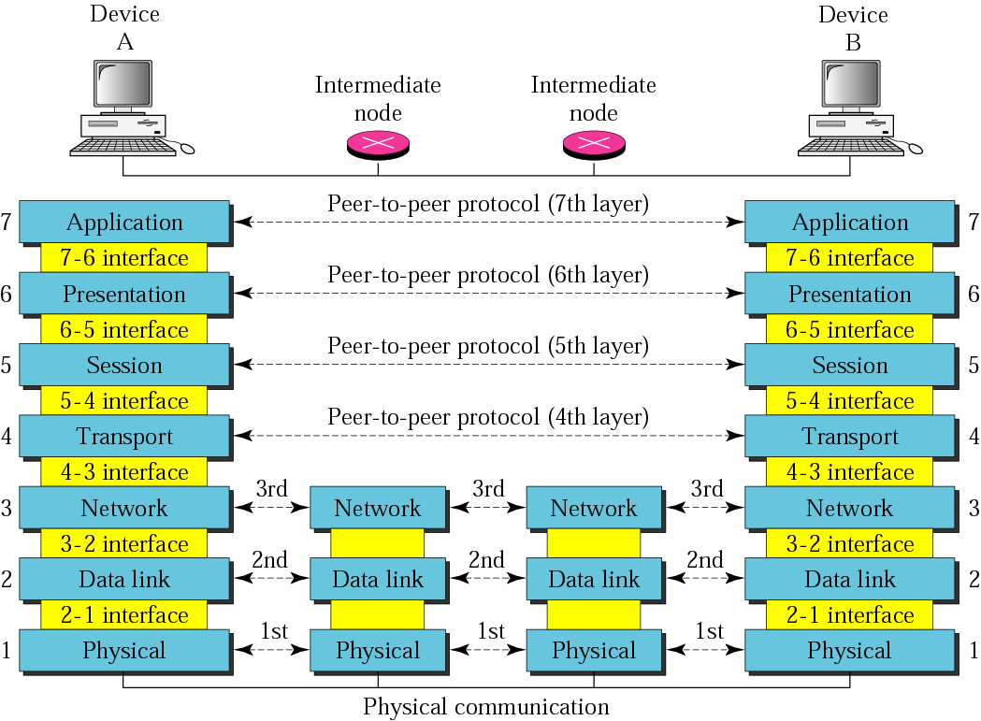
ISO’s OSI Reference Model

Slide 5
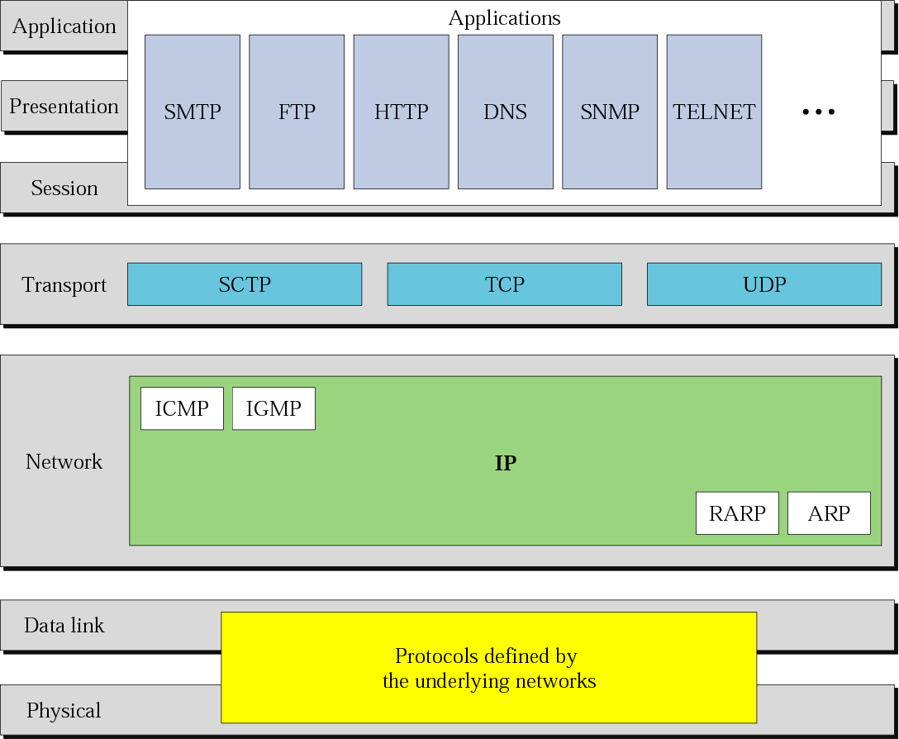
TCP/IP and OSI Model

Slide 6
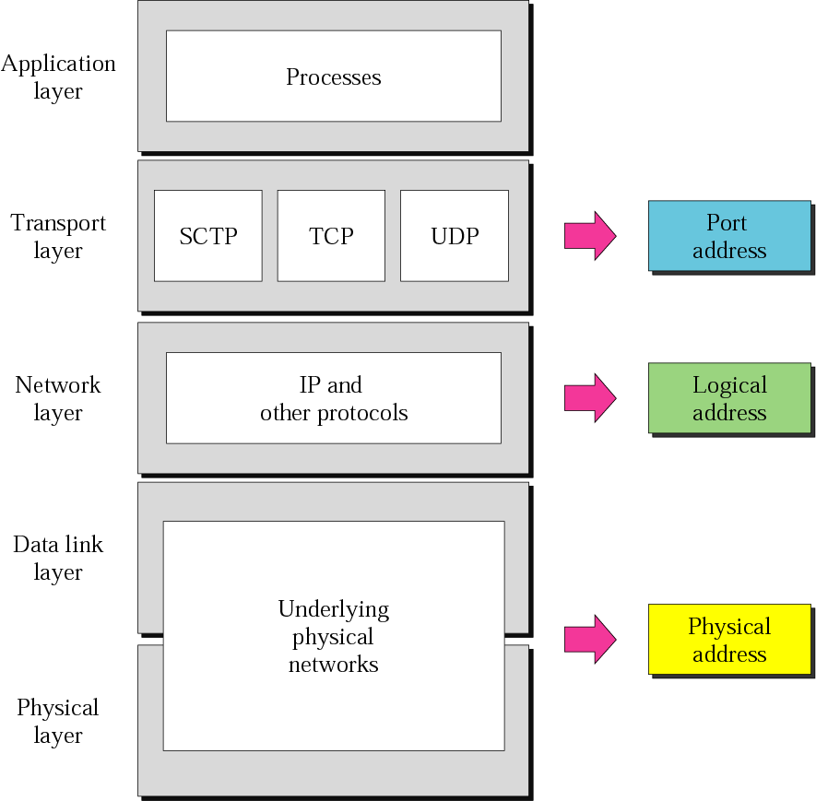
Types of Address

Slide 7
Address Translation
Computer Name
TCP/UDP Port Number
IP Address
MAC Address
DNS
ARP/RARP

Slide 8
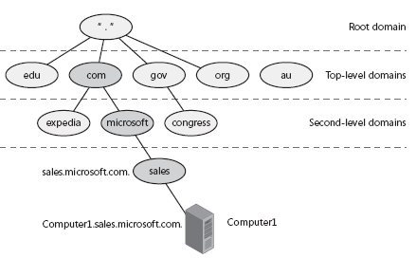
Domain Name System
The Domain Name System (DNS) is used on the Internet and on many private networks.
DNS Converts Domain Name to IP

Slide 9
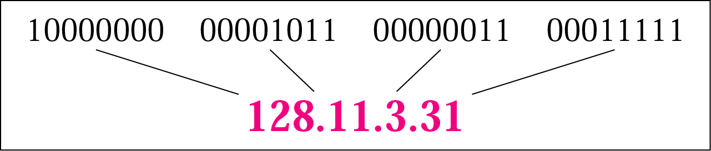
IP Addressing
The IP addresses are unique and universal.
An IP address is a 32-bit address.

Slide 10
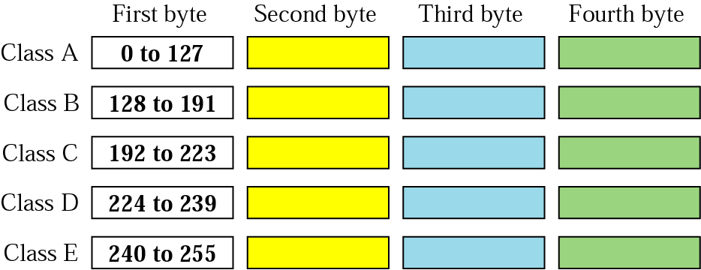
Classes of IP Address
UNICAST IP Addresses : Class A, B & C
MULTICAST IP Addresses : Class D

Slide 11
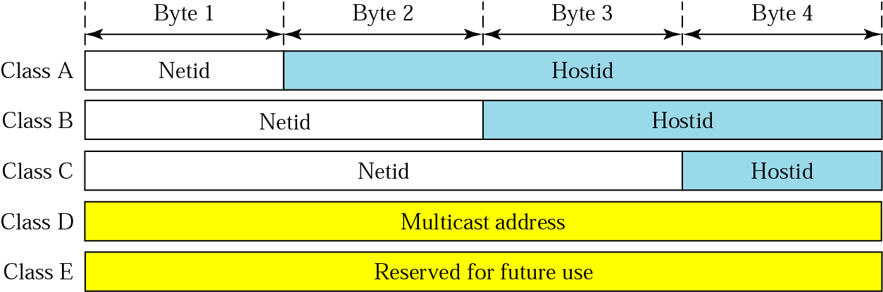
Net-ID & Host-ID

Slide 12
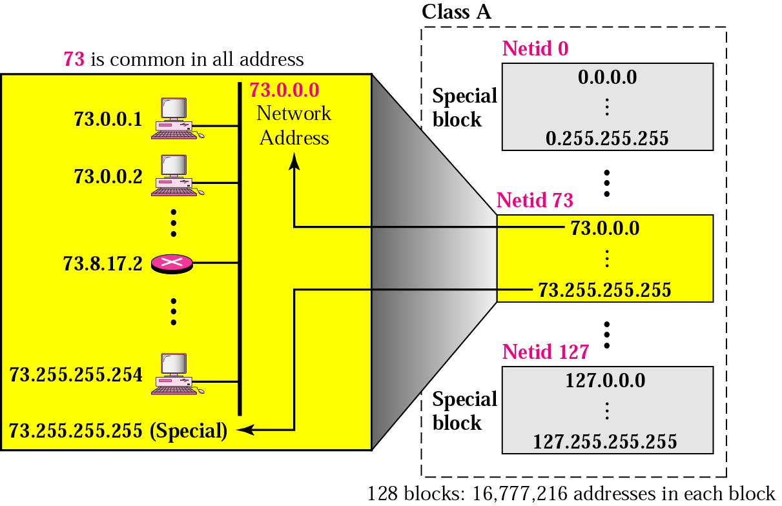
IP Addresses - Class A
Gateway Address ?

Slide 13
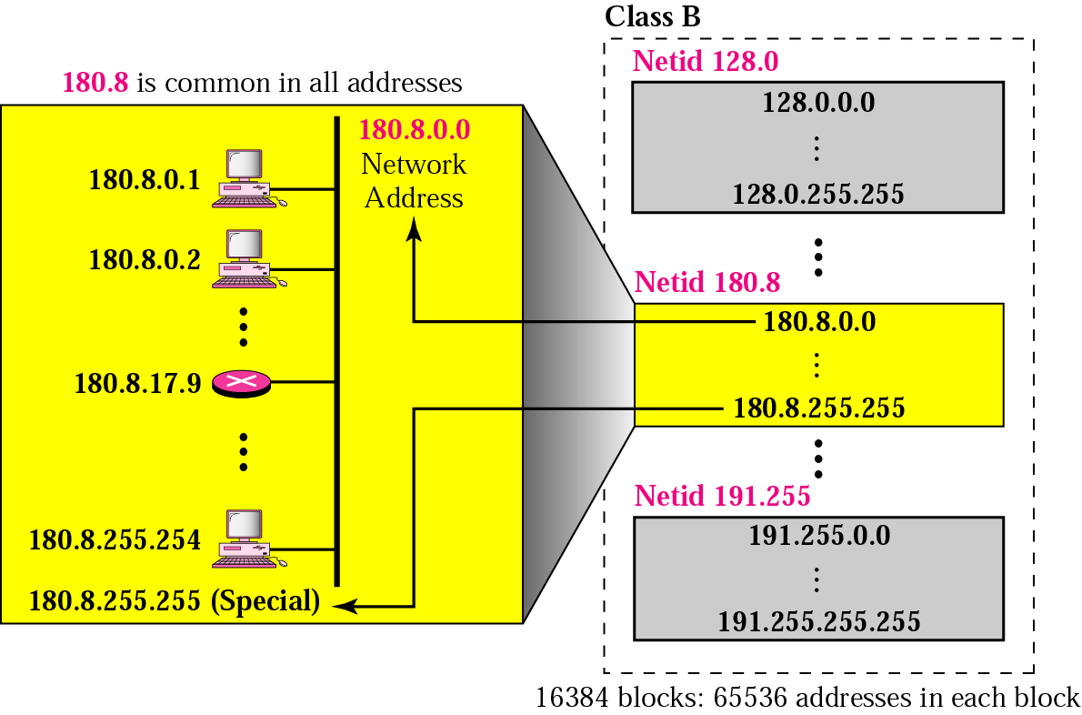
IP Addresses - Class B

Slide 14
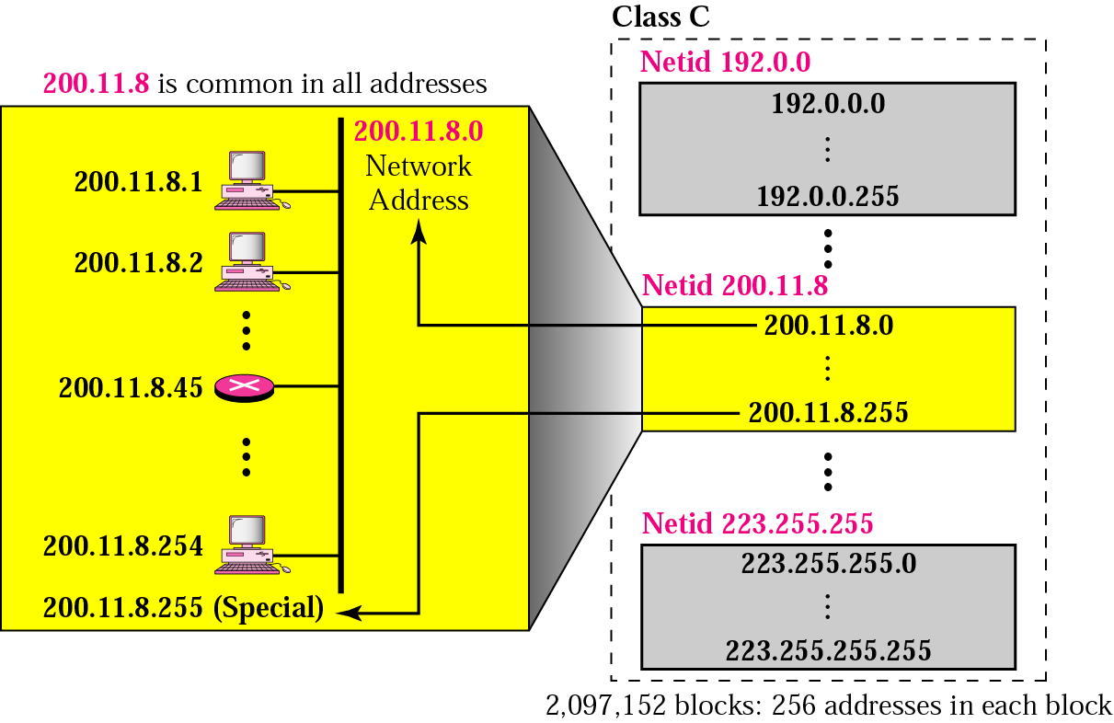
IP Addresses - Class C

Slide 15
VLSM & Classless Addressing
Subnet Mask?
Network Address = IP Address & Subnet mask

Slide 16
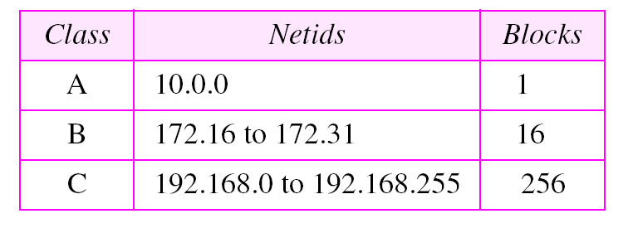
Loop Back & Private Addresses
Loop back Address : 127.0.0.1

Slide 17
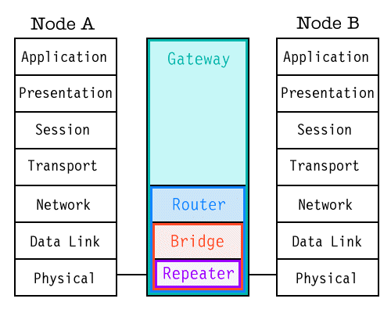
Interconnection Devices

Slide 18
Interconnection Devices
Repeater / HUB
  What, Where & When to use?
Bridge / Layer 2 Switch
  What, Where & When to use?
Router / Layer 3 Switch
  What, Where & When to use?
Gateway (Proxy/Firewall)
  What, Where & When to use?

Slide 19
WAN – Interconnections
Dialup Connection
  ?
ISDN
  ?
DSL
  ?
ATM
  ?

Slide 20
Network Services & Protocols
Data Services | File Sharing | FTP | 21
 | Email | SMTP & POP | ?
Web Services | Web Server | HTTP / HTTPS | ?
 | Proxy/Firewall Server | NAT/PAT | ?
Multimedia Services | Voice Over IP | SIP & H.323 | ?
 | Audio & Video Conferencing

Slide 21
Programming Assignment
Program to convert IP address
    Dotted decimal string to 4-byte unsigned Integer
    4-byte unsigned Integer to Dotted decimal string
Program for address translation and translation cache
  Machine Name to IP
  IP to Machine Name
  IP to MAC
  MAC to IP
Program to generate all possible IP Address within a specific network
  Input : IP Address and Subnet mask
  Output: All possible IP Addresses including
    Gateway (normal)
    Unicast (All Possible)
    Broadcast
Survey : Provide list of functions that perform , DNS , ARP , PING , Address Conversion, Byte Ordering
Note:
  Write functions for each task given above,
  Perform each task in all C, C# and Java

